Slide 1
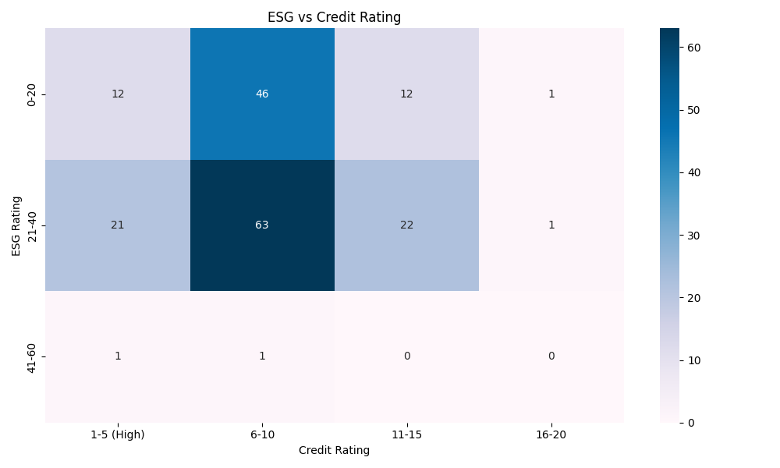
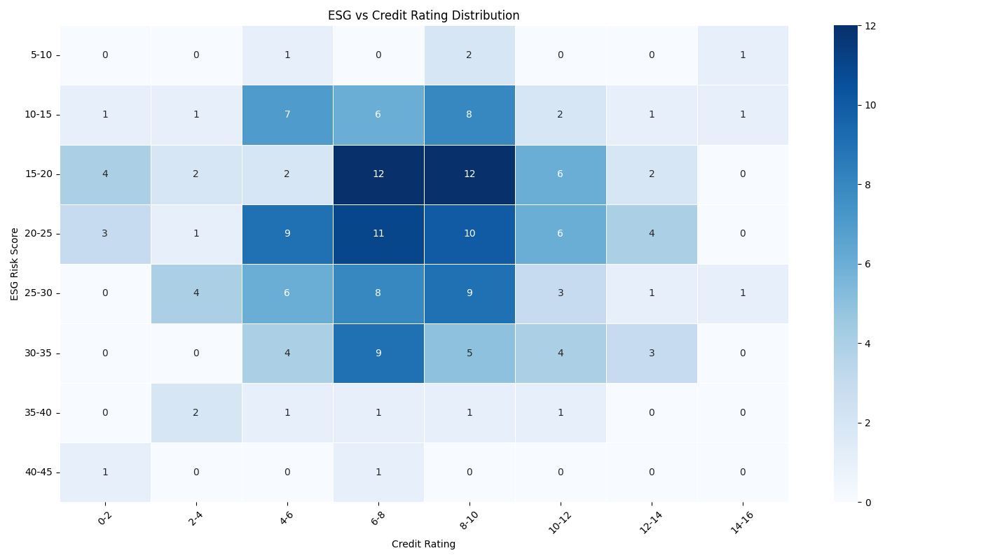
Cross Distribution of customer for credit rating vs ESG score
Dataset (‘combined_data’) includes 181 rows, variables included: ‘Total ESG Risk Score’, (credit) ‘Numerical Rating’) – converted from ‘Rating’
Before: 3 ESG bins, 4 credit bins
After: 8 ESG bins, 8 credit bins
1. No Strong Linear Trend
While there is some clustering, there is no clear linear relationship between ESG risk and credit rating. Companies with both good and bad credit ratings are spread across different ESG risk levels, suggesting other factors influence creditworthiness beyond ESG considerations.
2. Highest Density Cluster
The densest region appears around ESG scores 20-25 and credit ratings 6-10, indicating that most companies in this dataset have moderate ESG risk and mid-tier credit ratings.

Slide 2

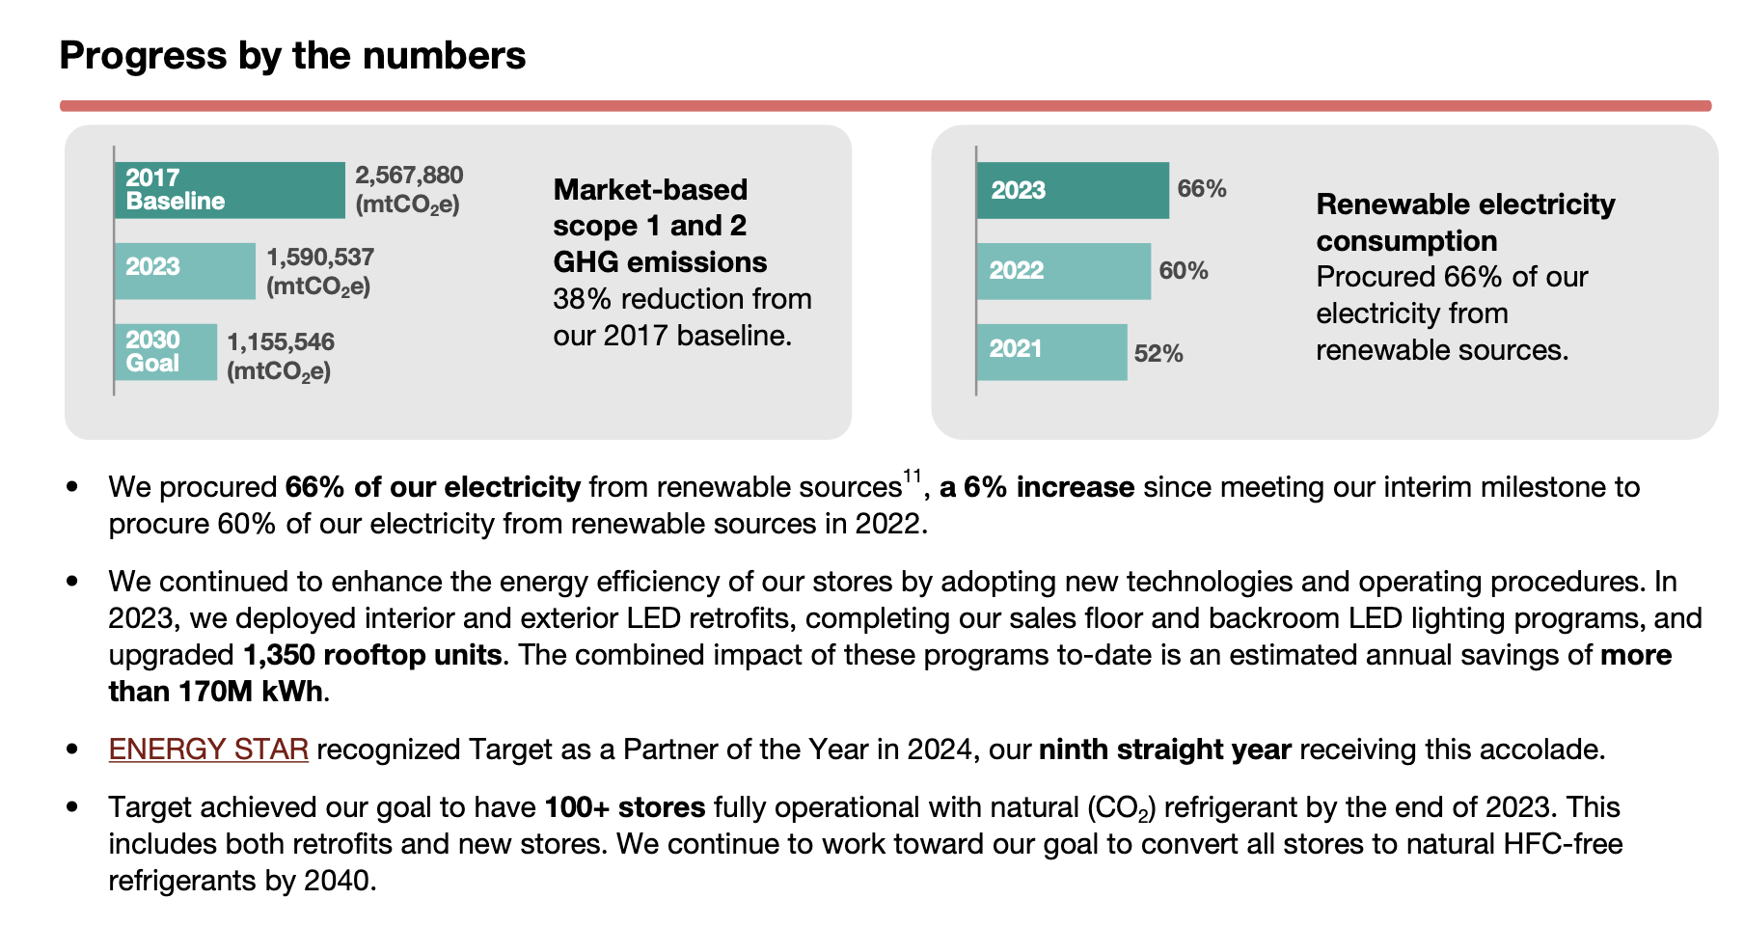

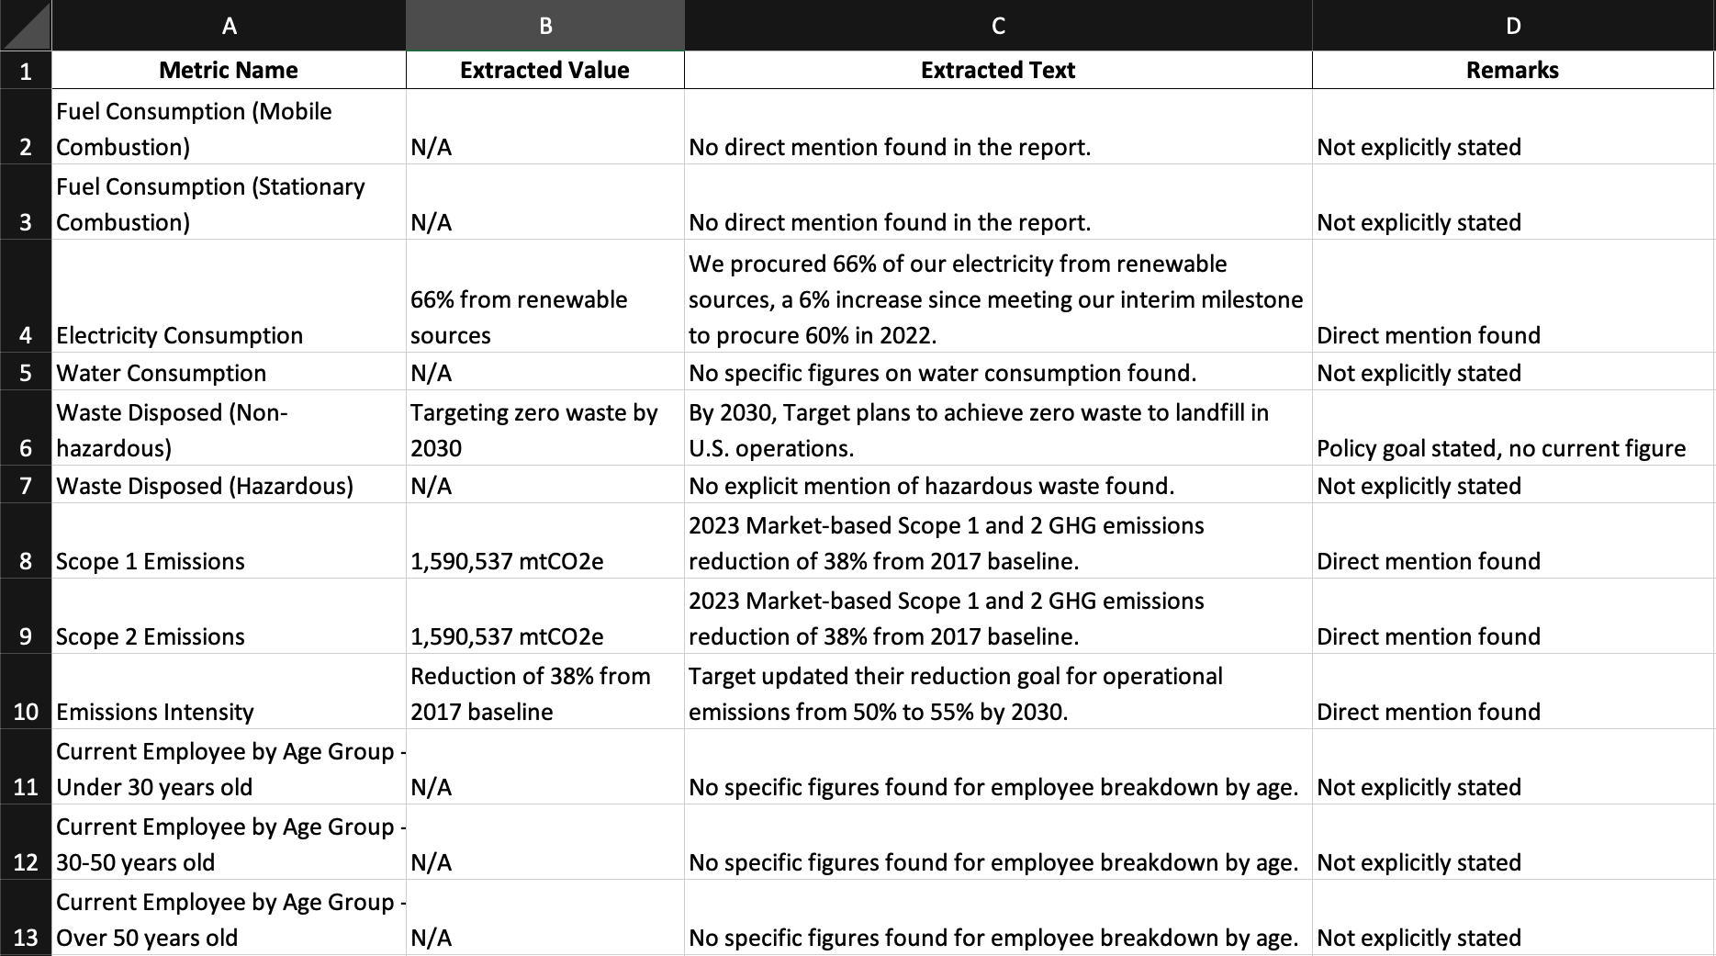
ESG Metric Extraction Framework
Task Overview: Framework is designed for an AI model to analyse ESG (environmental, social and governance) reports and extract key ESG metrics based on a predefined list. Extracted data is then structured into an Excel file for further analysis
1. Input company sustainability report and framework scans the text for key metrics
2. Extract numerical values if explicitly stated
3. Use NLP techniques to infer or calculate estimates when direct values are missing
4. Provide context by including relevant supporting text, and include remarks when information is inferred or indirectly mentioned.

Slide 3
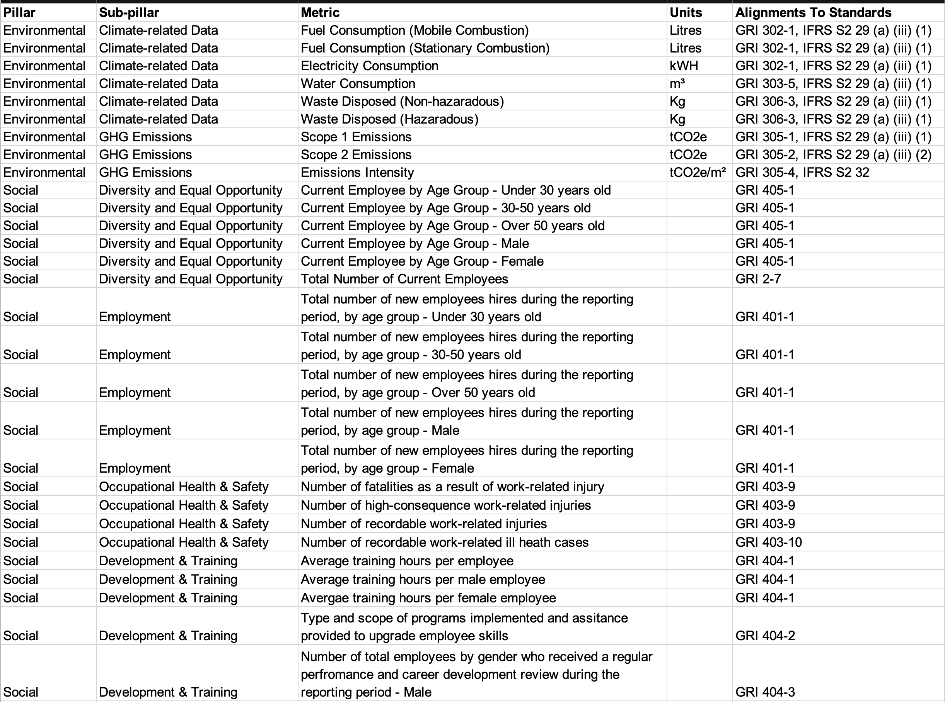
Key ESG Metrics for Extraction – available in sample ESGpedia report
Environmental Metrics:
Fuel Consumption (Mobile Combustion)
Fuel Consumption (Stationary Combustion)
Electricity Consumption
Water Consumption
Waste Disposed (Non-hazardous)
Waste Disposed (Hazardous)
Scope 1 Emissions
Scope 2 Emissions
Emissions Intensity
Social Metrics:
Current Employee by Age Group (Under 30, 30-50, Over 50)
Current Employee by Gender (Male, Female)
Total Number of Current Employees
Total number of new employees hired by age group & gender
Number of fatalities as a result of work-related injury
Number of high-consequence work-related injuries
Number of recordable work-related injuries
Number of recordable work-related ill-health cases
Average training hours per employee (Total, Male, Female)
Type and scope of programs implemented to upgrade employee skills
Employees who received a performance and career review (by gender)
Governance Metrics:
Number of Independent Board Directors
Number of Women on the Board of Directors
Anti-corruption policy presence
Number of operations assessed for corruption risks
Significant risks related to corruption identified
Number and percentage of governance body members trained on anti-corruption
Number and percentage of employees trained on anti-corruption
Fig. Sample of list of extracted metrics from ESGpedia sample report

Slide 4
Output Format, NLP Techniques for extraction and Expected Response
NLP Techniques for Extraction
Identify percentages, proportions, or related numerical statements.
Convert numbers mentioned in text format into numerical values.
Cross-check other sections of the report for implied figures.
Identify qualitative statements suggesting approximate values.
Expected Response
File Format: Downloadable Excel File
Conditions:
If a metric is not found, use NLP to deduce possible values.
Provide remarks explaining whether the value was estimated, inferred, or unavailable.
Future Improvements:
Enhance metric categorisation – add brief descriptions for each category, such as “Environmental Metrics: Metrics related to resource usage, emissions and employee development”
Expanding NLP models to handle industry-specific terminology, integrating external data sources for validation and improving inferential accuracy for missing metrics.
Output Format
File Type: Excel (.xlsx)
File Naming Convention: {Report Name}_Extracted_ESG_Metrics.xlsx
Columns in the Output File:
Metric Name – The ESG metric extracted
Extracted Value – The numerical or qualitative value found
Extracted Text – Supporting text from the report
Remarks – Notes on whether the value was directly found, estimated, or inferred

